Slide 2
Note: Any videos in this presentation will only play online. After you download the slideshow, you will need to also download the videos from YouTube & add them back into your PowerPoint.
We present these messages at Bee Creek Park in College Station, TX. If you would like to watch the video of the service with this message, click here:
http://campaignkerusso.org/?p=11926
We would love to know more about the people who download our lessons & sermons. We invite you to email us & let us know where & how you use them.
info@ckbrazos.org

Slide 4
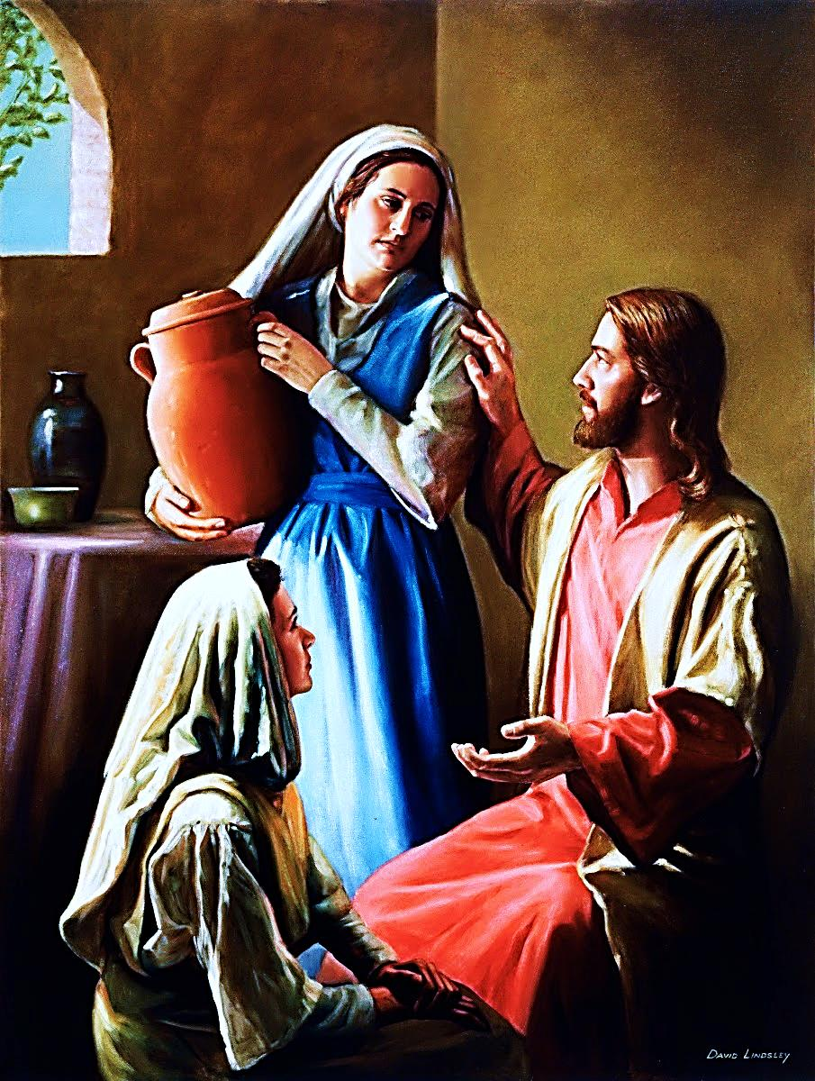
Luke 10:38-42
As Jesus and his disciples were on their way, he came
to a village where a woman named Martha opened her home to him. She had a
sister called Mary, who sat at the Lord’s feet listening
to what he said.
But Martha was distracted
by all the preparations
that had to be made. She came to him and asked, “Lord, don’t you care that my sister has left me to do the work by myself? Tell her to help me!”

Slide 5
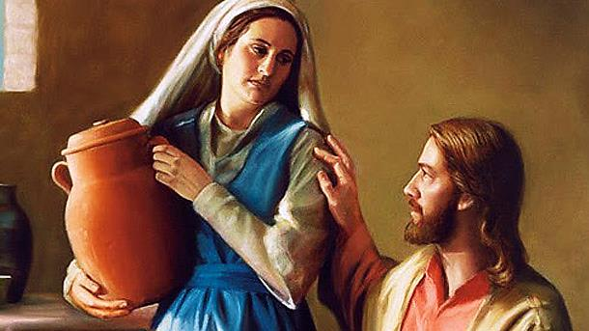
Luke 10:38-42
“Martha, Martha,” the Lord answered, “you are worried and upset about many things, but few things are needed—or indeed only one. Mary has chosen what is better, and it will not be taken away from her.”

Slide 6
Next Slide: Song - Mary and Martha Download Here: https://www.youtube.com/watch?v=tNfXW5jU-Os

Slide 7
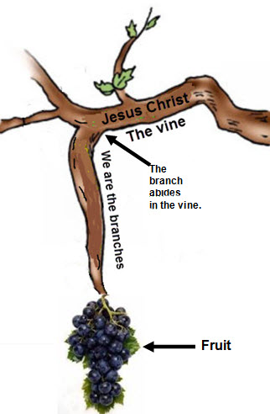
John 15:4-5
Live in me, and I will live in you.
A branch cannot produce any fruit
by itself. It has to stay attached
to the vine. In the same way, you
cannot produce fruit
unless you live in me.
I am the vine. You are the branches.
Those who live in me while I live
in them, will produce a lot of fruit.
But you can't produce anything
without me.

Slide 8
God works
FROM
THE INSIDE
OUT

Slide 9
Next Slide: Song – Bible Theater, Mary and Martha Download Here: http://youtu.be/C91ygWW2u0U

Slide 10
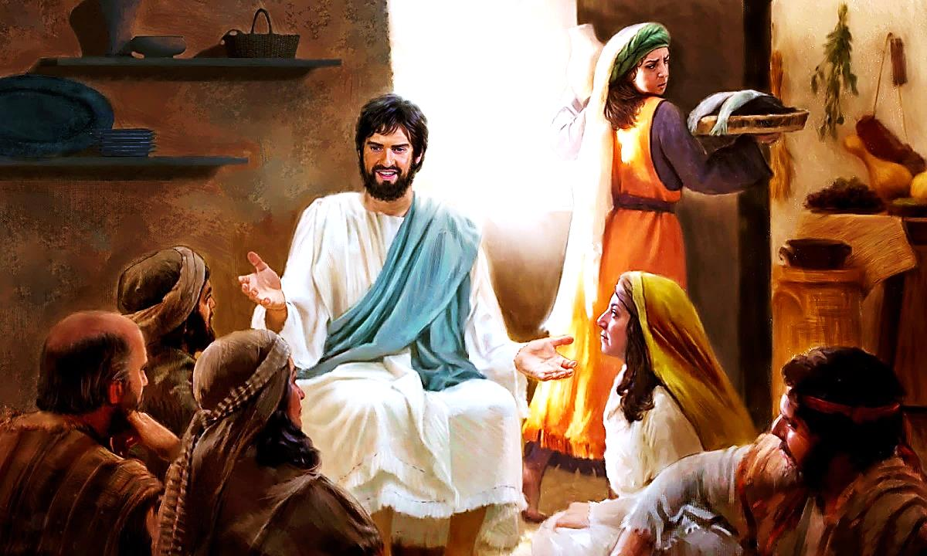
Who’s at the center of this picture?
Martha got so caught up in her role as a hostess, that she lost her patience. Mary, sitting at the feet of Jesus, became the “bad guy” in Martha’s eyes simply because she was not doing enough to help Martha make everything perfect.

Slide 11
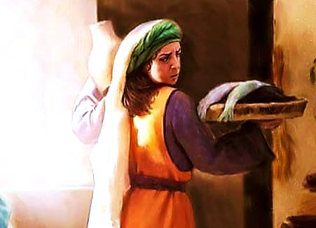
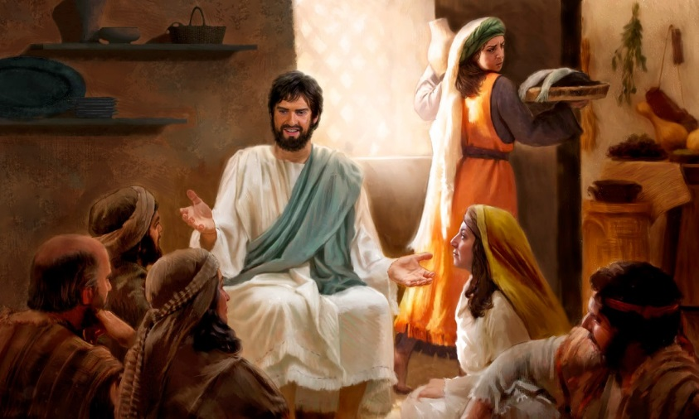
The center of this event was Jesus, but Martha lost sight of Jesus….Her own service became the center of the event!
Even Christian service can sometimes be a distraction from focusing on Christ Himself.

Slide 12
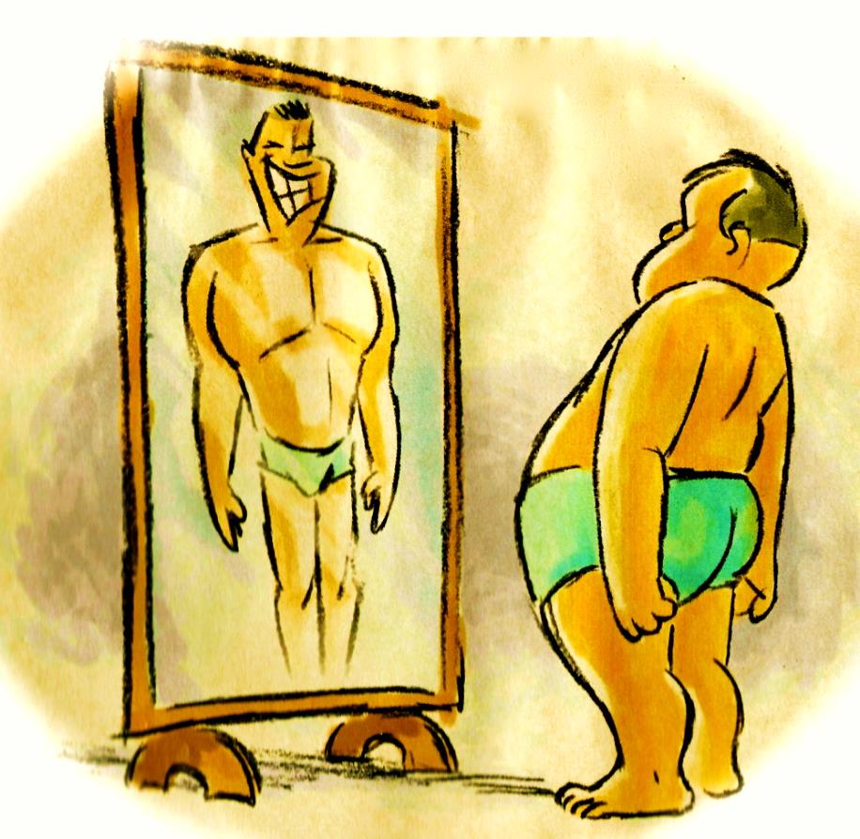
Though nothing is wrong with doing service for the Lord, but we must not think our service makes us look any better to God

Slide 13
Our Plan
God’s Plan

Slide 14
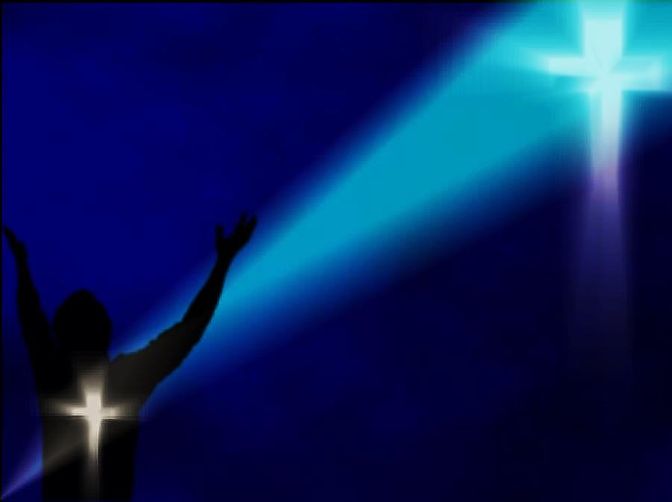
We’ve got to let God work
FROM
THE INSIDE
OUT

Slide 15
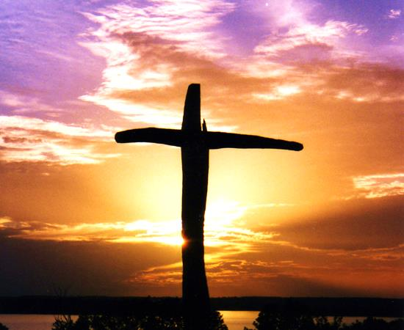
For God presented Jesus as the sacrifice for sin. People are made right with God when they believe that Jesus sacrificed his life, shedding his blood.
This sacrifice shows that God was being fair when he held back and did not punish those who sinned in times past Rom 3:25

Slide 16
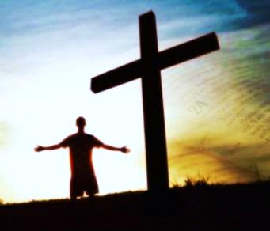
for he [God] was looking ahead and including them in what he would do in this present time. God did this to demonstrate his righteousness,
for he himself is fair and just, and he declares sinners to be right in his sight when they believe in Jesus. Rom 3:26

Slide 17
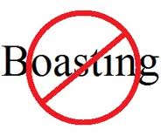
Can we boast, then, that we have done anything to be accepted by God?
No, because our acceptance is not based on obeying the law. It is based on faith. Rom 3:27

Slide 18
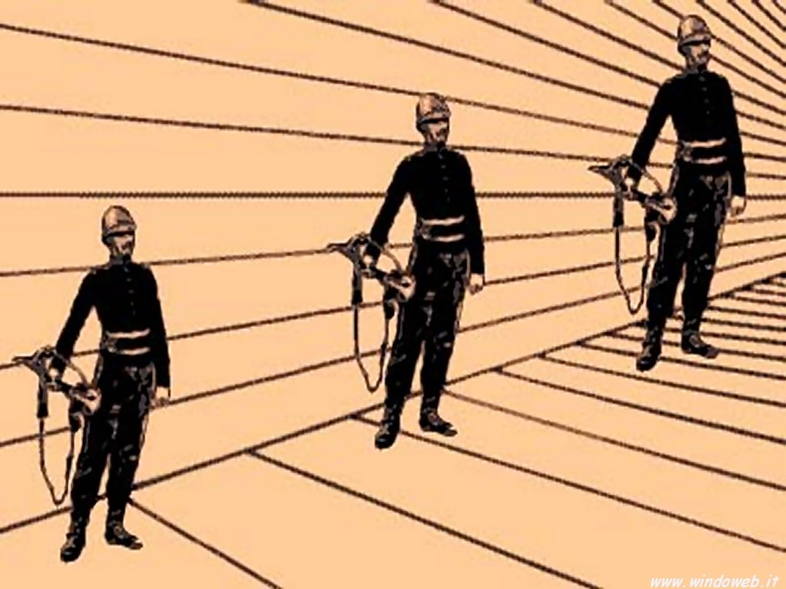
Who is tallest ?

Slide 19
Man cannot help himself. He will always compare himself with his fellow man, his deeds, his successes, his achievements, etc. The only fair gospel to all men is one that totally rejects the efforts of all men, but instead offers God’s free gift of salvation for all men.

Slide 20
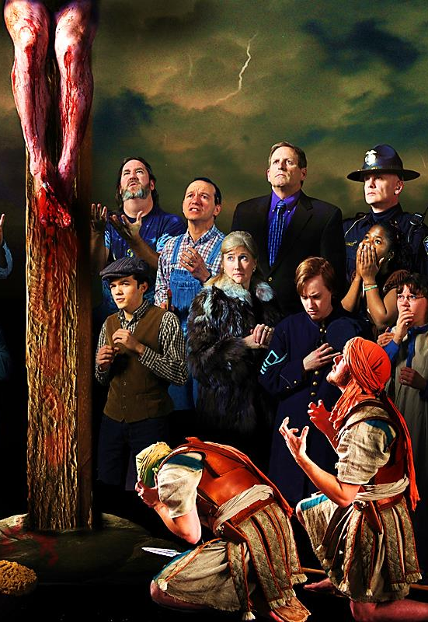
This means that no one is “higher” or better than another when standing before God. We all have the same thing in common, according to the gospel message: that is, we are all utterly lost in sin and must all turn to the solution which lies outside of ourselves, that solution being the sacrifice of Jesus on the Cross.

Slide 21
Next Slide: Song - “I Am Nothing (Without You)” Download Here: https://www.youtube.com/watch?v=W4wxxG_GRB0

Slide 22
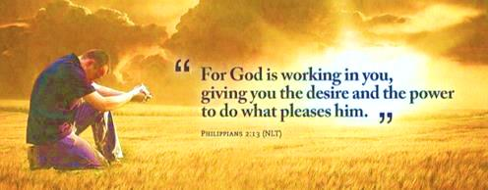
God’s plan is to work on us,
FROM THE
INSIDE OUT

Slide 23
Next Slide: Song – From the Inside Out Download Here: https://www.youtube.com/watch?v=prGl5kOzDWc

Slide 24
Is Jesus Speaking to You?
“They said to each other, ‘Did not our hearts burn within us while he talked to us on the road, while he opened to us the Scriptures?’”
John Wesley Said:
“…the preacher was describing the change which God works in the heart through faith in Christ and I felt my heart strangely warmed.”
Jesus makes His presence Known by a small voice!

Slide 26
What is the Sinner‘s Prayer?
This is a prayer we can pray when we are ready to admit we are sinners and need Christ’s forgiveness.
It must be prayed with faith in our hearts and a readiness to have a life-changing encounter with Jesus Christ.

Slide 27
A prayer of faith → Pray this prayer if :
If you never have before
You have in the past, but you think it would mean more today
You have been walking afar off and you want to come back
You want to set an example & show others how it is done
You just like to give your heart to Jesus again & again
Faith

Slide 28
We Declare Our Faith Publicly Because Jesus Declared His LOVE Publicly
“If you stand before others and are willing to say you believe in me, then I will tell my Father in heaven that you belong to me.” Mat 10:32

Slide 29
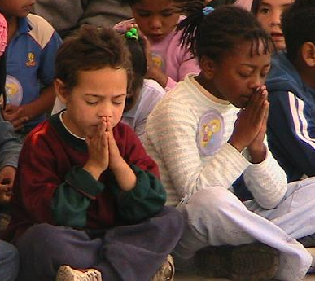
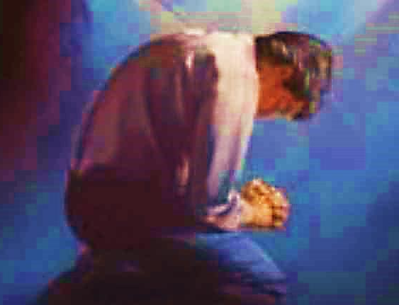
Important Questions
Do you want to know Jesus as your Savior right now?
Do you believe He died to save you from your sins & that He rose from the dead?
Do you believe that He is here, waiting to save you right now?

Slide 30
The Prayer of a Sinner Turning to Jesus
Dear Jesus, I know that I have sinned against You and that my sins separate me from You.
I am truly sorry.
Right now, I turn away from my sinful past .
Please forgive me, and help me to keep from sin.
I believe You died for my sins.
I Believe You rose from the dead, you are alive, and you hear this prayer from my heart.
I invite You Jesus to be both my Savior and the Lord of my life.
I want You to rule my life from now on.

Slide 31
“But some people did accept him. They believed in him, and he gave them the right to become children of God.”
John 1:12

Slide 33
“If you openly say, ‘Jesus is Lord’ and believe in your heart that God raised him from death, you will be saved.”
Rom. 10:9
What did you learn today?
What have you been thinking about God lately?
What do you want to tell others about Jesus?

Slide 34
“Draw near to God, and He will draw near to you…
Altar Time
…Cleanse your hands, you sinners, and make your hearts pure, you who are half-hearted towards God.” James 4:8 WNT

Slide 35
Close in Prayer

Slide 36
Note: Any videos in this presentation will only play online. After you download the slideshow, you will need to also download the videos from YouTube & add them back into your PowerPoint.
We present these messages at Bee Creek Park in College Station, TX. If you would like to watch the video of the service with this message, click here:
http://campaignkerusso.org/?p=11926
We would love to know more about the people who download our lessons & sermons. We invite you to email us & let us know where & how you use them.
info@ckbrazos.org

Slide 37
Welcome to Aggieland Faith Family Style Worship

Slide 38
CURRENT SCHEDULE: www.Aggielandfaith.org
Three Sunday Sermons
From 2 pm till about 4 pm
Through the New Testament
Through the Old Testament
Topical or Series
(Current Series: Tabernacle)

Slide 39
Would You Like Prayer or Bible Study at Your House?
Personal Prayer: We can come to your home & pray with you, or you can email us when you need prayer.
Home Bible Study: We will come to your home & hold a bible study for you & your friends.
Bible Party: We will hold a Kid’s Bible Party: You provide the food & kids - we will do the bible fun & stories.

Slide 40
Would You Like Visitation?
We will visit a friend, loved one in the hospital or in prison to pray for them & share Christ with them.
Contact: info@aggielandfaith.org

Slide 41
www.aggielandfaith.org
Go here to see pictures & videos
Go here to subscribe to e-mails about changes & cancellations

Slide 42
Note: Any videos in this presentation will only play online. After you download the slideshow, you will need to also download the videos from YouTube & add them back into your PowerPoint.
We present these messages at Bee Creek Park in College Station, TX. If you would like to watch the video of the service with this message, click here:
http://campaignkerusso.org/?p=11926
We would love to know more about the people who download our lessons & sermons. We invite you to email us & let us know where & how you use them.
info@ckbrazos.org

